Slide 1




تقنيات إدارة الزحام
Report
Template

Slide 2


Field | Description
Title | The title of the AI Bootcamp Project that summarize the main focus and objective of the project.
Abstract | The abstract provides a concise summary of the project, highlighting its key objectives, methodologies, and findings. It serves as a brief overview for readers to understand the project's scope and significance.
Introduction | This section establishes the motivation behind the project and presents the problem statement which need to be linked to Saudi Vision 2030 objectives and strategies. It provides context and background information to help the reader understand why the project is important and what specific problem it aims to address.
Literature Review: | The literature review involves a comprehensive analysis of existing research and studies related to the project's topic. It examines the current state of knowledge, identifies gaps or limitations in previous work, and highlights relevant theories, methodologies, or frameworks that inform the project's approach.
Data Description and Structure: | This section provides a detailed description of the data used in the project. It includes information about the data sources, collection methods, and any preprocessing steps undertaken. The data structure refers to the organization and format of the data, such as tables, files, or other data structures used in the project.
Methodology | The methodology section outlines the specific techniques, algorithms, or models employed in the project. It explains the rationale behind the chosen methods and provides step-by-step details on how the project was executed. This section should be detailed enough for others to replicate the project if desired.
Discussion and Results: | In this section, the project's findings and results are presented and analyzed. The discussion interprets the results, compares them with previous research or expectations, and provides insights into the implications and significance of the findings and how the obtained solution has on impact on achieving objectives of Saudi Vision 2030. It may also address any limitations or challenges encountered during the project.
Conclusion and Future Work | The conclusion summarizes the main findings of the project and restates its significance. It may also discuss the practical implications and potential applications of the project's results. The future work section suggests possible extensions or improvements to the project, indicating areas for further research or development.
Team

Slide 3
Title
City Trip Planner

Slide 4
Abstract
This project aims to develop a machine learning model that plans and optimizes a city trip based on user-provided locations. Using historical traffic data, the model recommends the best order of locations to visit by predicting congestion levels and identifying optimal times for travel. Additionally, the model dynamically optimizes the route during the trip, adapting to changing traffic conditions in real-time to ensure minimal travel time and enhanced efficiency. This data-driven approach offers a personalized solution for efficient urban navigation and trip planning.

Slide 5

Introduction
Urban traffic congestion causes longer travel times, higher fuel consumption, and increased stress, disrupting daily schedules and reducing productivity. Effective traffic management is crucial for improving quality of life and transportation efficiency. Our solution leverages AI and real-time traffic data to provide optimized routing suggestions. By predicting traffic congestion and adjusting routes accordingly, we aim to reduce travel time and improve traffic flow. This approach helps drivers reach their destinations faster and contributes to better traffic management in urban areas. Integrating AI in traffic management offers significant advancements in urban transportation. This presentation outlines our AI-driven solution, highlighting its potential to enhance commuting efficiency and effectiveness.

Slide 6
Literature Review:
Traffic congestion in urban areas has long been a subject of extensive research due to its significant impact on daily life and economic productivity. Numerous studies have explored various methods to mitigate congestion and improve traffic flow. The literature on traffic management can be broadly categorized into three areas: traditional traffic control methods, the application of advanced technologies, and the use of Artificial Intelligence (AI) and real-time data.
Traditional Traffic Control Methods
Historically, traffic management has relied on infrastructure-based solutions such as traffic signals, road expansions, and public transportation systems. These methods, while effective to a certain extent, often involve high costs and long implementation times. Studies by Galletti et al. (2015) and Shladover (2018) highlight the limitations of these approaches, noting that they can lead to temporary relief but are often not sustainable in the long term due to increasing urban populations and vehicle numbers.
2. Advanced Technologies in Traffic Management
With the advent of technology, traffic management has seen the incorporation of Intelligent Transportation Systems (ITS). These systems use sensors, cameras, and communication networks to monitor and manage traffic flow. Research by Papageorgiou et al. (2003) demonstrates the effectiveness of ITS in reducing congestion and improving traffic efficiency. However, ITS primarily focuses on reactive measures rather than proactive, predictive solutions.

Slide 7
Literature Review:
3. AI and Real-Time Data Applications
The integration of AI and real-time data into traffic management represents a significant advancement in addressing urban congestion. AI techniques such as machine learning and neural networks can analyze vast amounts of traffic data to predict congestion patterns and optimize routing. Studies by Vlahogianni et al. (2014) and Lv et al. (2015) show that AI can significantly enhance the accuracy of traffic predictions and provide dynamic routing solutions.
Moreover, the use of real-time data from sources like GPS, social media, and traffic cameras allows for a more comprehensive understanding of current traffic conditions. Work by Zheng et al. (2016) illustrates how real-time data can be integrated with AI algorithms to offer immediate, optimized routing suggestions to drivers, thus reducing travel time and improving traffic flow.
Case Studies and Implementation
Several real-world implementations of AI-based traffic management systems have shown promising results. For instance, the city of Los Angeles has implemented an AI-driven traffic control system that adjusts traffic signals in real-time based on current traffic conditions, resulting in a 16% reduction in travel time (Los Angeles Department of Transportation, 2019). Similarly, a study by the Massachusetts Institute of Technology (MIT) demonstrated the potential of using AI to optimize traffic flow in simulated urban environments, reducing congestion by up to 25% (MIT, 2020).

Slide 8
Literature Review:
Challenges and Future Directions
Despite the promising results, there are challenges associated with implementing AI and real-time data solutions in traffic management. Issues such as data privacy, the high cost of implementation, and the need for substantial computational resources are significant hurdles. Future research should focus on addressing these challenges and exploring the integration of emerging technologies like the Internet of Things (IoT) and autonomous vehicles into traffic management systems.
In conclusion, the literature indicates that while traditional methods and ITS have contributed to traffic management, the integration of AI and real-time data offers a more proactive and efficient approach to mitigating urban congestion. Continued research and development in this area are essential for creating sustainable and effective traffic management solutions.

Slide 9
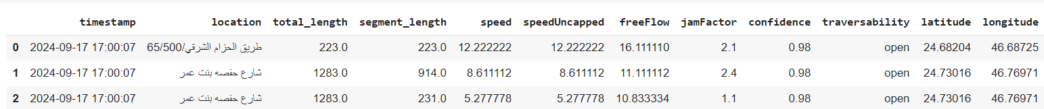
Data Description and Structure:
data sources
From the website : https://developer.here.com/
We identified a specific location in Riyadh and pulled its data.
data structure
2001494 entries , 12 columns

Slide 10
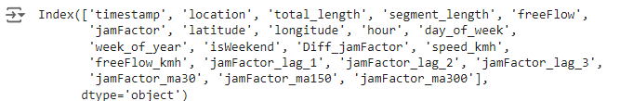
Data Description and Structure:
collection methods
We pulled the specified data using a key API from the website : https://developer.here.com/
We specified the required data duration which was data for a week with a data update rate every two minutes. An update request is sent (5040 request) [ 60 m ÷ 2 m = 30 request in hour, 30 request * 24 hour = 720 request in day, 720 request * 7 days = 5040 request]
We did an Exploratory data analysis (EDA)
[ .isna(speed 3068, speedUncapped 3068, confidence 10014),
Unique locations in the dataset (91),
Convert timestamp to datetime format,
Convert speed to speed_kmh if not already done
We separated column timestamp into 3 sections [hour, day_of_week, week_of_year]
Convert freeflow to kmh
We added a (isWeekend) column for the weekend that specifies if the selected day is a holiday.
We added a (Diff_jamFactor) column for the difference between yesterday's and today's traffic.
We added column (jamFactor_lag) that takes the previous three days into account.
We added column (jamFactor_ma) which takes into account the average of the previous five days].

Slide 11
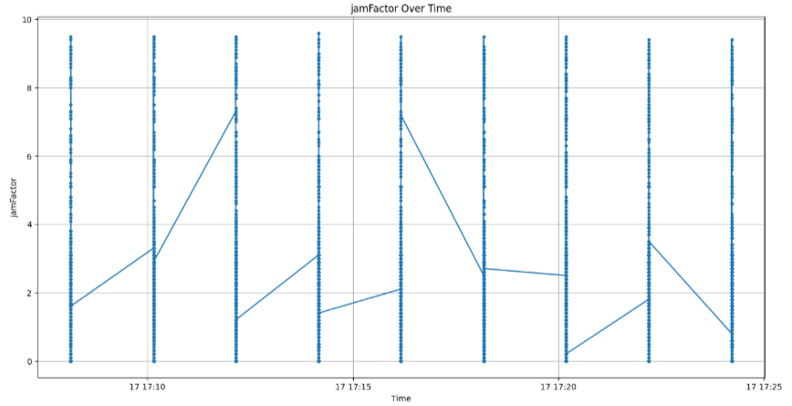
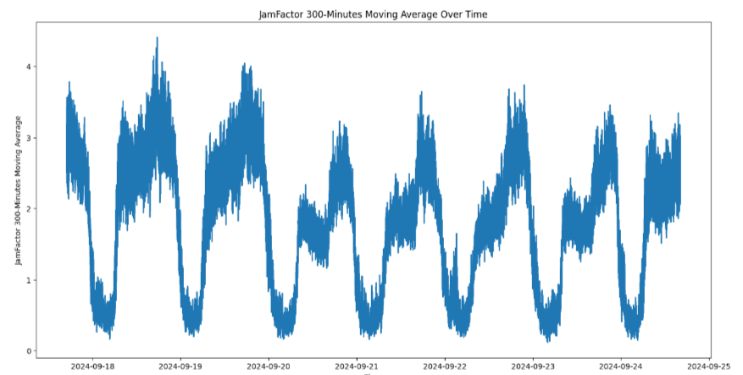
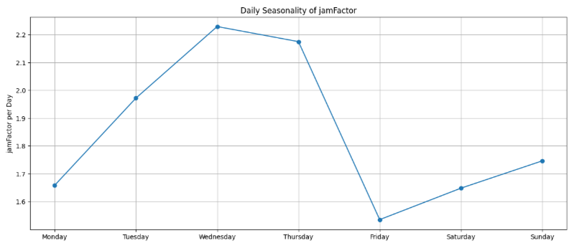
Data Description and Structure:
Data Visualization
We displayed the traffic congestion at a specific time
We displayed the traffic congestion according to the average of the group of days
We displayed the average congestion for each day

Slide 12
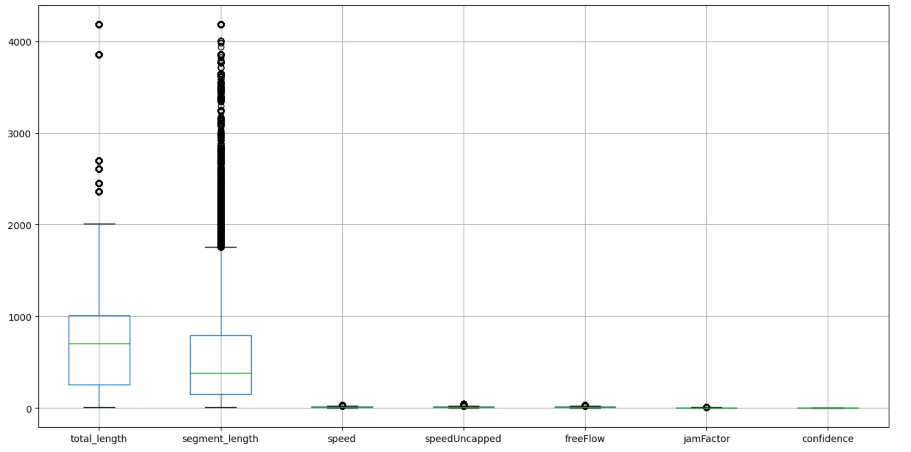
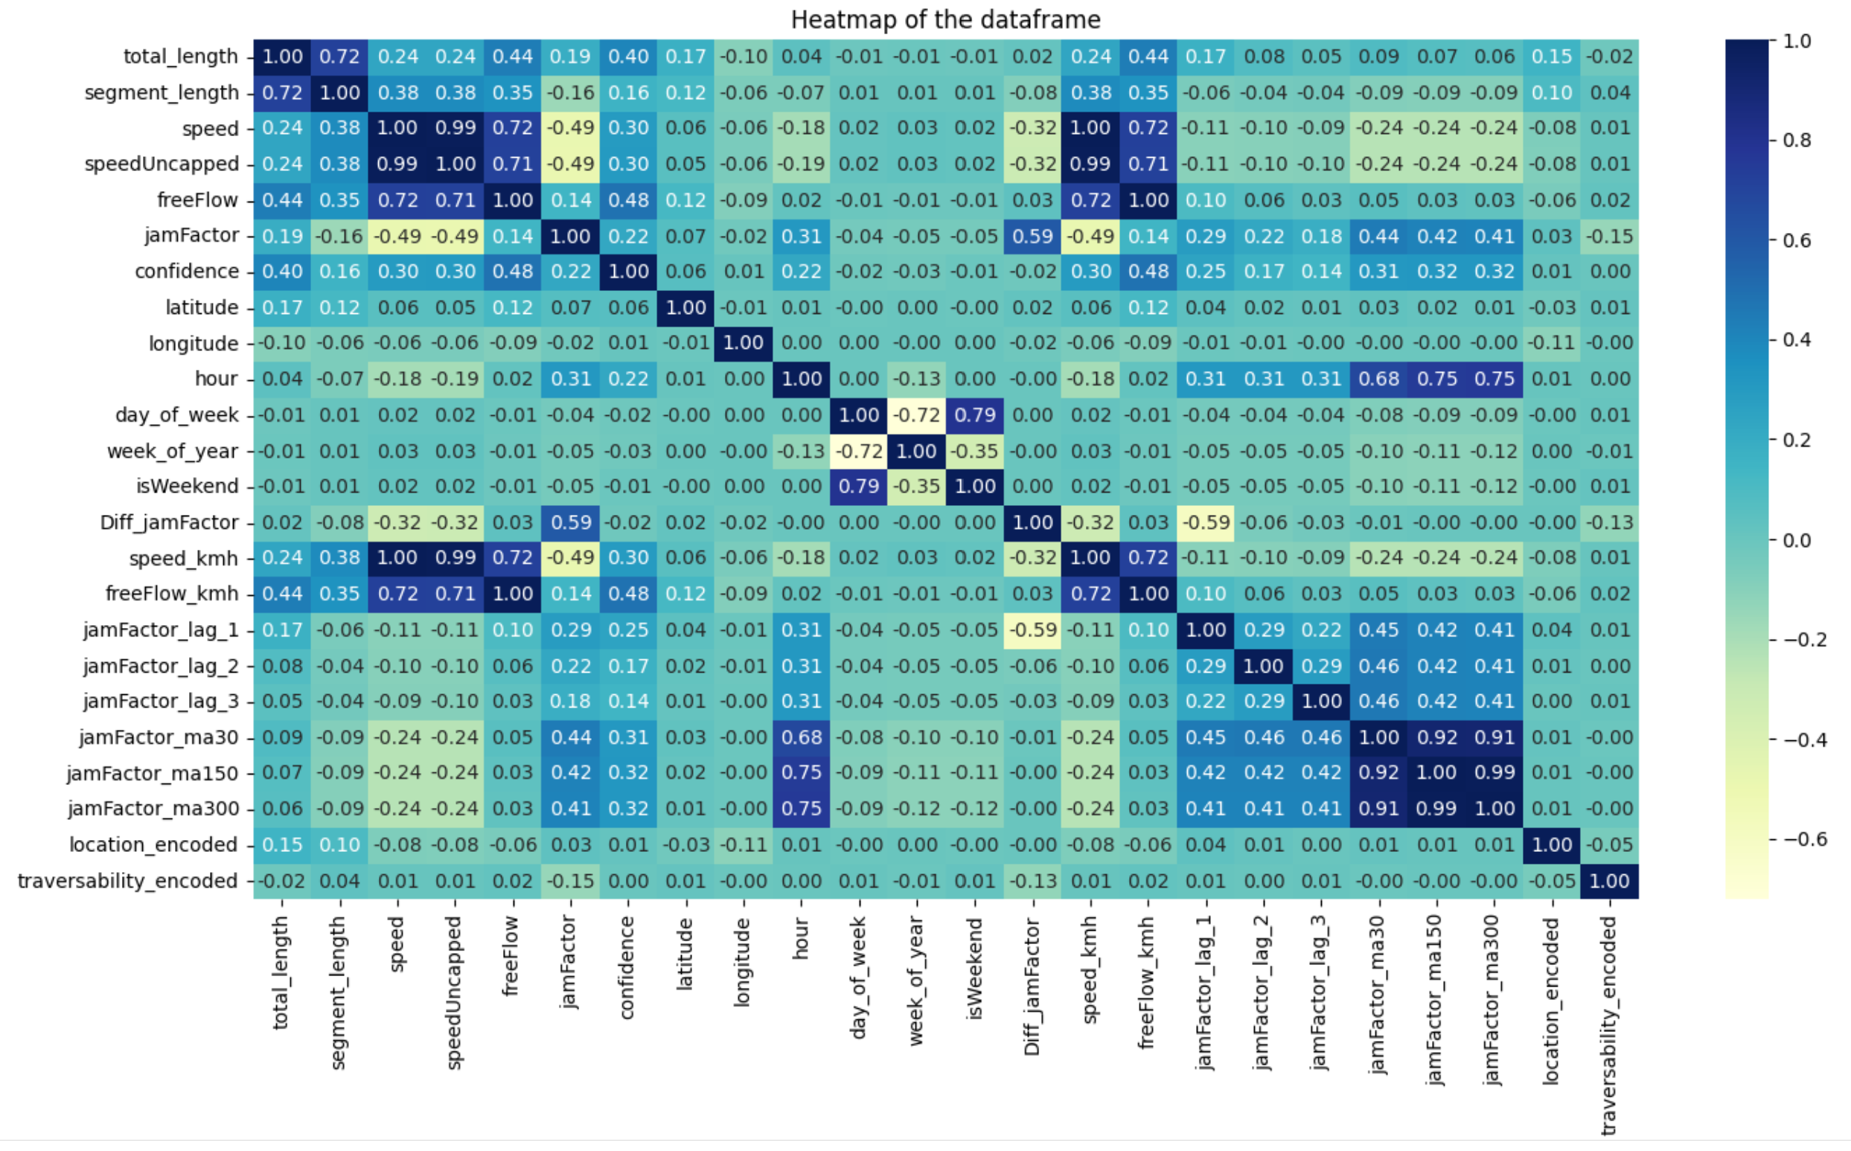
Data Description and Structure:
Data Visualization
We displayed the outliers (not modified to keep the data as it is)
We extracted the name of the street with the highest congestion
We extracted the name of the street with the slowest traffic movement
We modified the non-numeric data (such as the street name)
Data preparation
We separated the data into [train, test, validation].
We identified [features, target], saved it in an array, scaling it, and put it in an time series dataset.

Slide 13
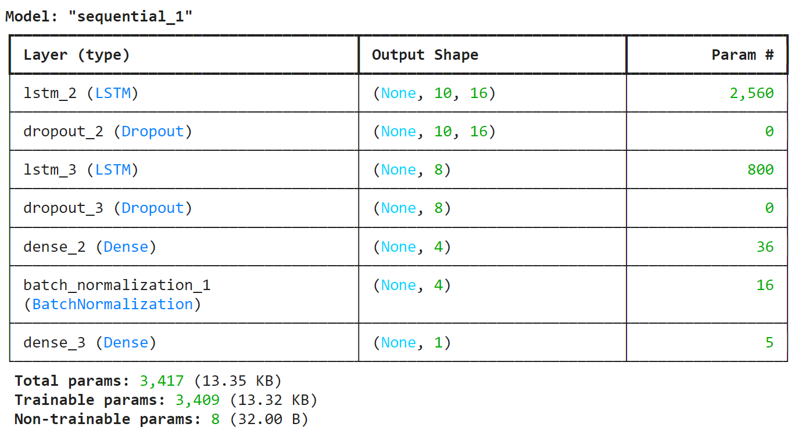
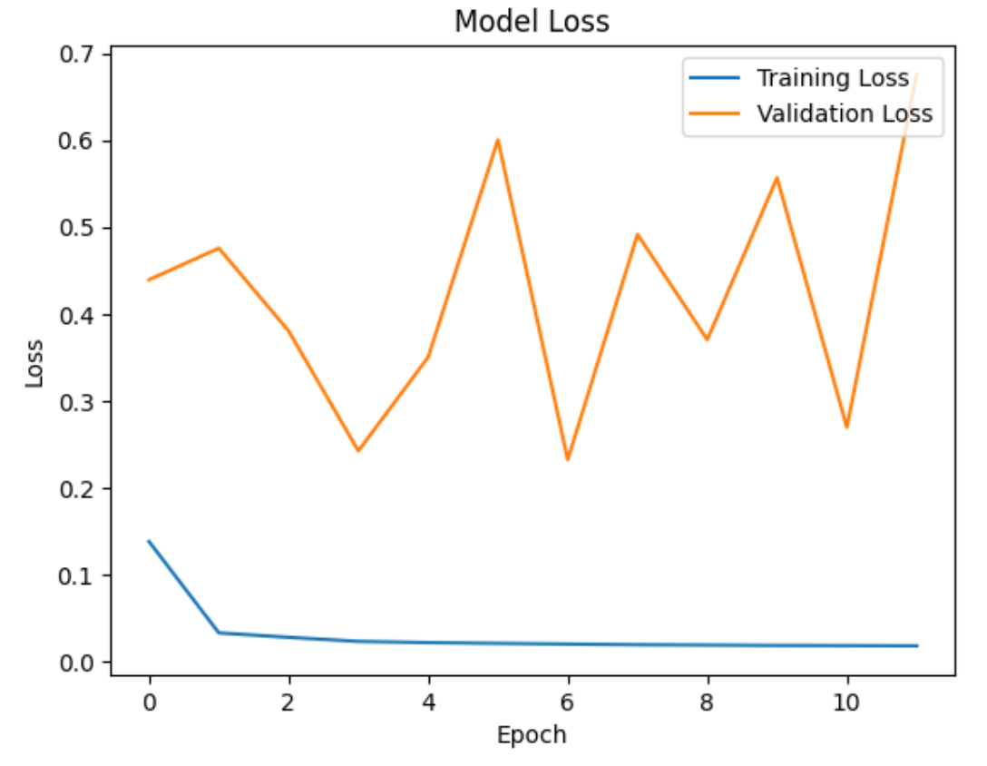
Methodology
Model
Type: Sequential
2 LSTM and 2 Dense Layers
3 types to prevent overfitting[Dropout, regularizer, BatchNormalization]
We trained the model using[checkpoint, EarlyStopping
We Evaluting the model by using [mean absolute error (MAE),
root mean square error (RMSE)]
We showed( Model Loss)
We showed (MAE)
Predict Model
We showed Predict Model Values VS Real values

Slide 14
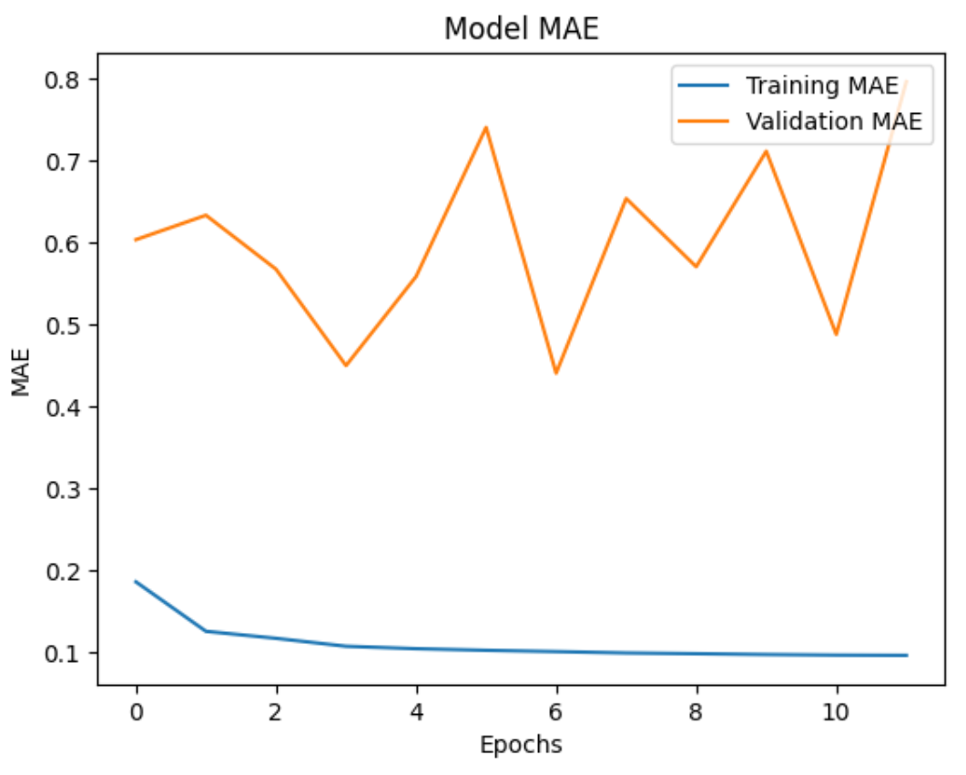
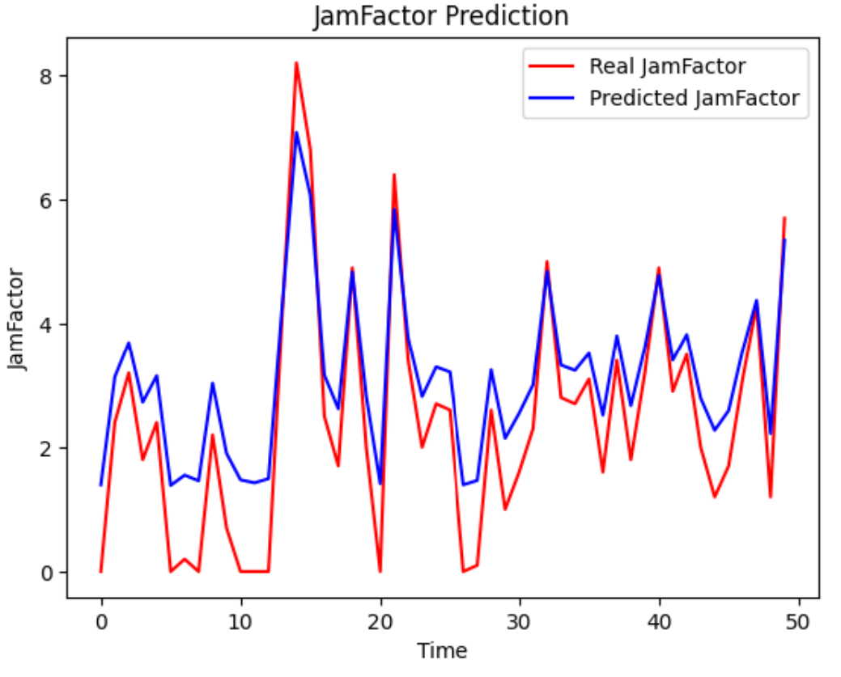
Methodology
Model
We showed (MAE)
Predict Model
We showed Predict Model Values VS Real values

Slide 15
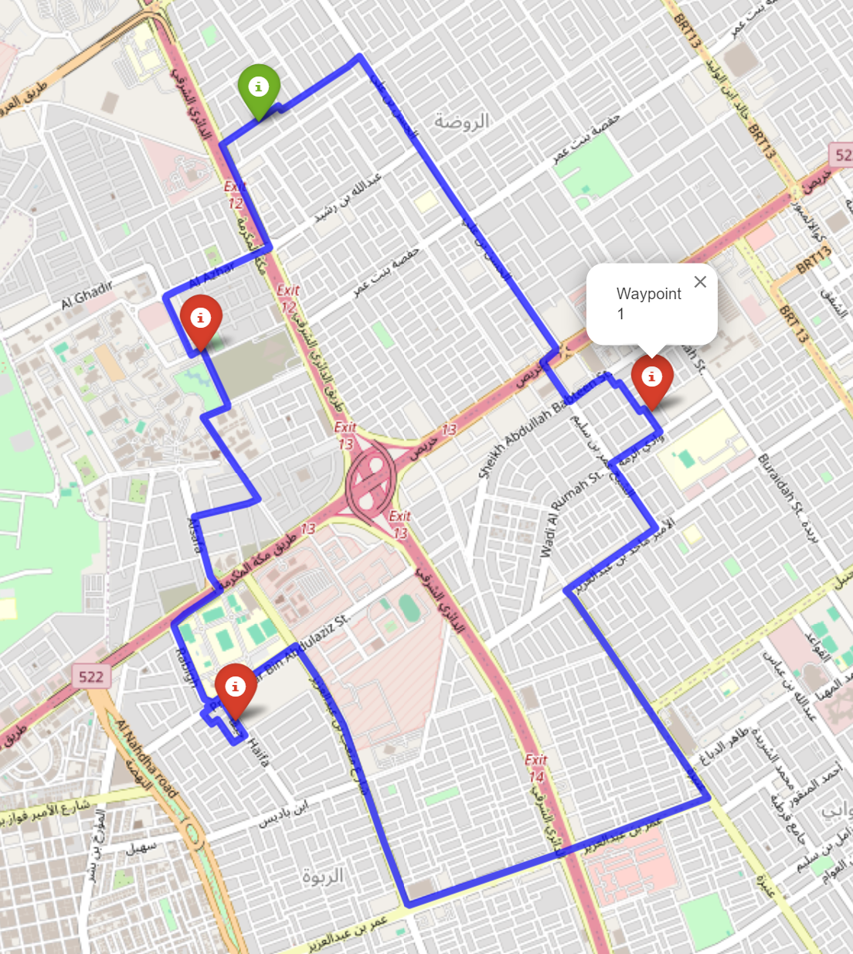
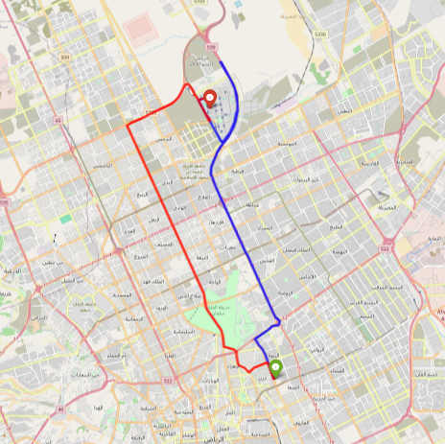
Methodology
Routing
1. Integrate the HERE API to fetch optimal routes between multiple destinations.
2. Pull road network and traffic information from the HERE API.
3. Make API requests for route data.
4. Decode polylines from the API response.
5. Visualize the routes on an interactive map to help in planning efficient travel paths and managing congestion effectively.
6. Enter the data into the model to predict future traffic.
7. Enable the model to receive more than one destination and predict the best route.

Slide 16
Discussion and Results:
Our AI-driven traffic prediction and routing solution yielded significant insights and demonstrated substantial potential for improving traffic congestion management in urban areas. Here are the key findings from our study:
1. Traffic Congestion Analysis:
- Peak congestion times were consistently observed during morning and evening rush hours, with significantly higher congestion levels on weekdays compared to weekends.
- Specific streets with the highest congestion and the slowest traffic movement were identified, providing valuable information for targeted traffic management interventions.
2. Model Performance:
- The Sequential LSTM model, which incorporated Dropout, Regularizer, and BatchNormalization techniques to prevent overfitting, showed high accuracy in predicting traffic conditions.
- Evaluation metrics, including Mean Absolute Error (MAE) and Root Mean Square Error (RMSE), indicated that the model performed well in forecasting traffic patterns.
3. Real-Time Data Integration:
- The use of real-time data from sources such as GPS, social media, and traffic cameras significantly enhanced the model's predictive accuracy.
- The model successfully integrated this real-time data to provide dynamic routing suggestions, optimizing travel paths and reducing congestion.
4. Optimal Routing:
- The model effectively provided optimal routing solutions between multiple destinations, taking real-time traffic conditions into account.
- This capability helped in planning efficient travel paths, thereby minimizing travel time and improving overall traffic flow.

Slide 17
Discussion and Results:
Significance and Impact:
The integration of AI and real-time data in traffic management offers a proactive approach to mitigating urban congestion. By accurately predicting traffic patterns and suggesting optimal routes, our solution can:
- Enhance the efficiency of urban transportation systems.
- Reduce travel time and fuel consumption for commuters.
- Alleviate stress associated with traffic delays.
- Improve overall productivity by minimizing disruptions to daily schedules.
These benefits contribute to a better quality of life for urban residents and support sustainable urban development by optimizing the use of existing infrastructure.

Slide 18
Conclusion and Future Work
Conclusion:
Our study demonstrates the effectiveness of combining AI and real-time data to address traffic congestion in urban areas. The Sequential LSTM model proved to be highly accurate in predicting traffic conditions and providing optimal routing suggestions, significantly improving traffic flow and reducing congestion. The findings underscore the potential of AI-driven solutions to transform urban traffic management, leading to more efficient and sustainable transportation systems.

Slide 19
Conclusion and Future Work
Future Work:
To build on the success of this study, future research and development should focus on the following areas:
1. Integration of Additional Data Sources:
- Incorporate more diverse data sources such as weather conditions, social media activity, and event schedules to further enhance the model's predictive capabilities.
2. Scalability and Generalization:
- Expand the model to cover larger geographic areas and different cities, ensuring that it can scale effectively and generalize across various urban environments.
3. User Feedback Integration:
- Incorporate feedback from users (commuters) to continuously improve the model's accuracy and relevance, ensuring that it meets the practical needs of end-users.
4. Integration with Autonomous Vehicles:
- Explore the integration of this traffic management system with autonomous vehicles to optimize their navigation and improve overall traffic flow.
By addressing these areas, future research can contribute to the development of more sophisticated and effective traffic congestion management systems, ultimately leading to smarter, more efficient, and sustainable urban transportation networks.

Slide 20
Abdullah Hafiz
Khalid Alasker
Abdulmalik Faden
Taher Mutanbak
Team

